Slide 1


Block Chain

Slide 2

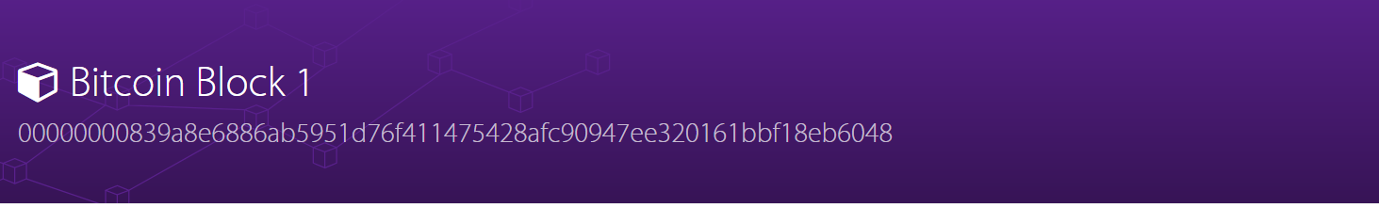
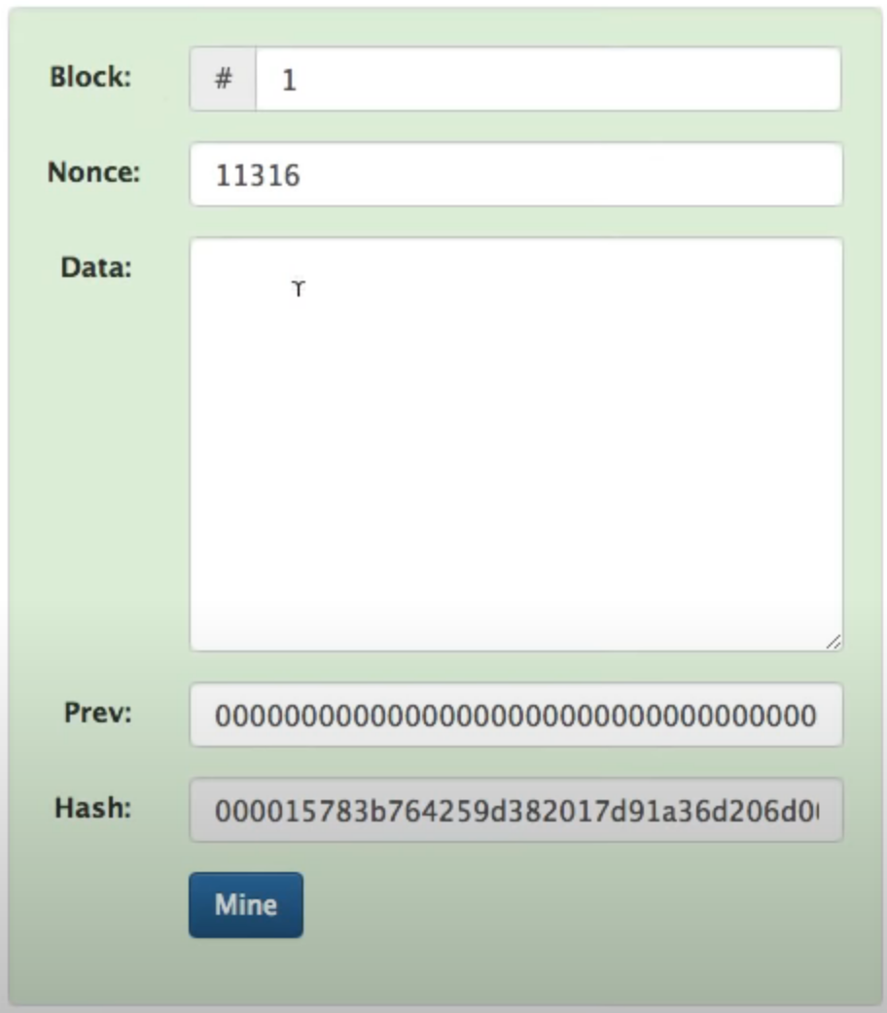
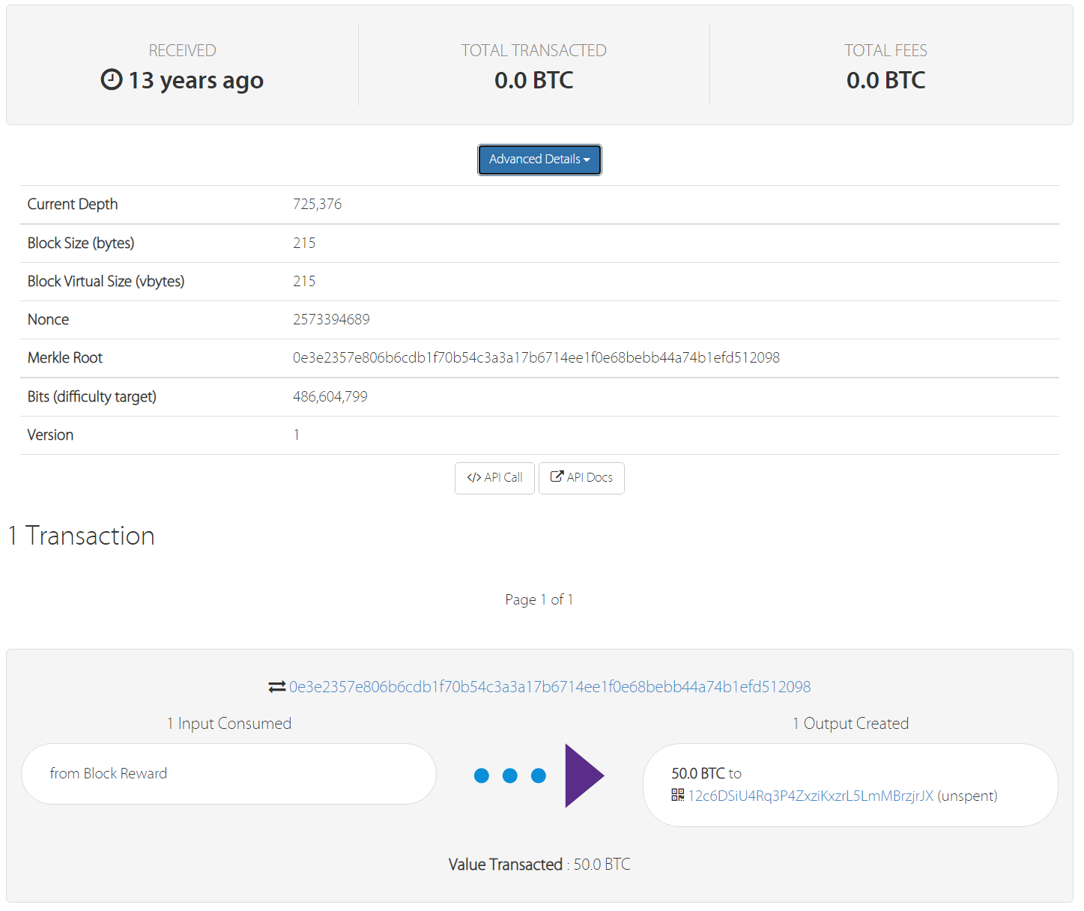
What is a block?

Slide 3
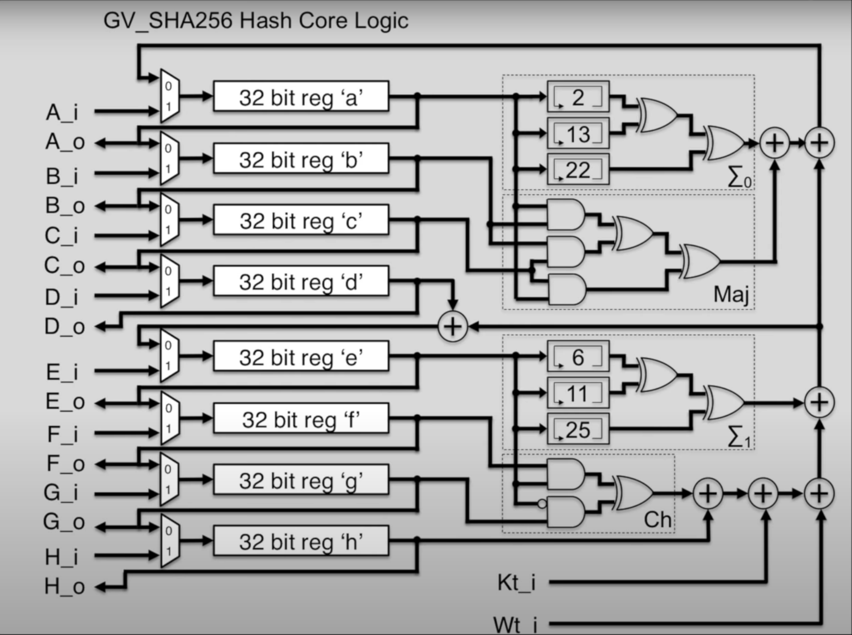
What is a Hash?
000000006a625f06636b8bb6ac7b960a8d03705d1ace08b1a19da3fdcc99ddbd

Slide 4
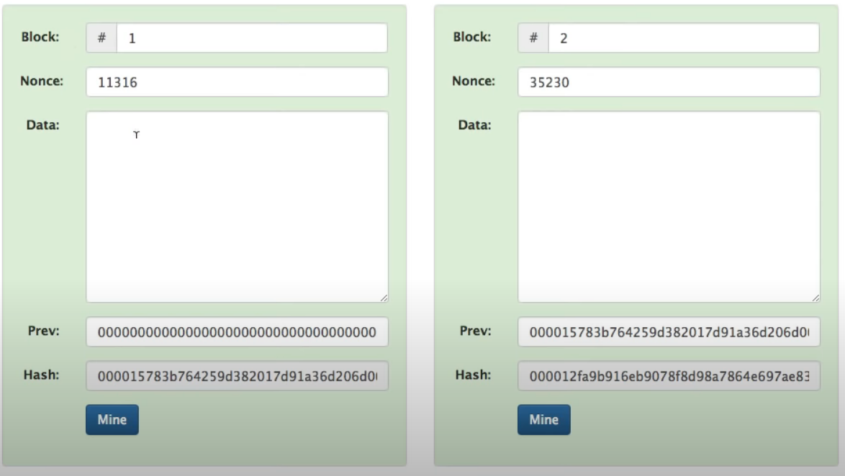

Slide 5
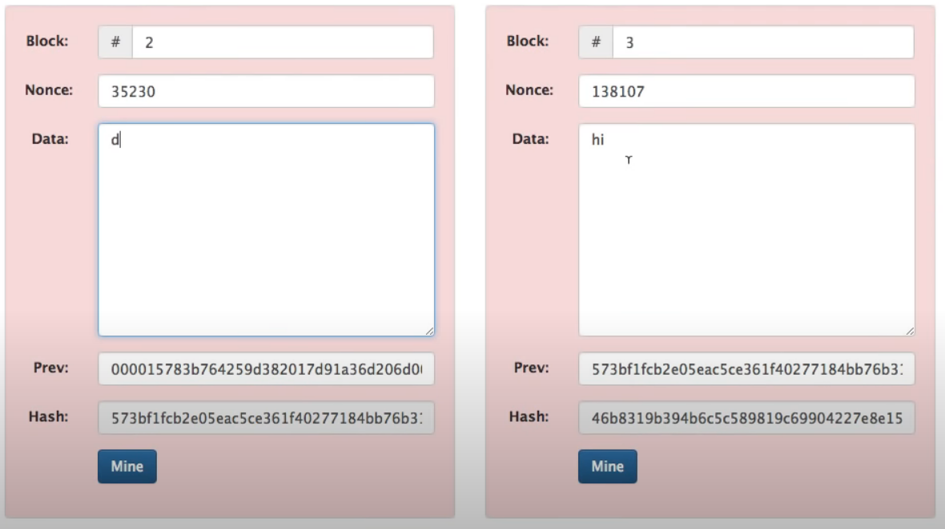

Slide 6
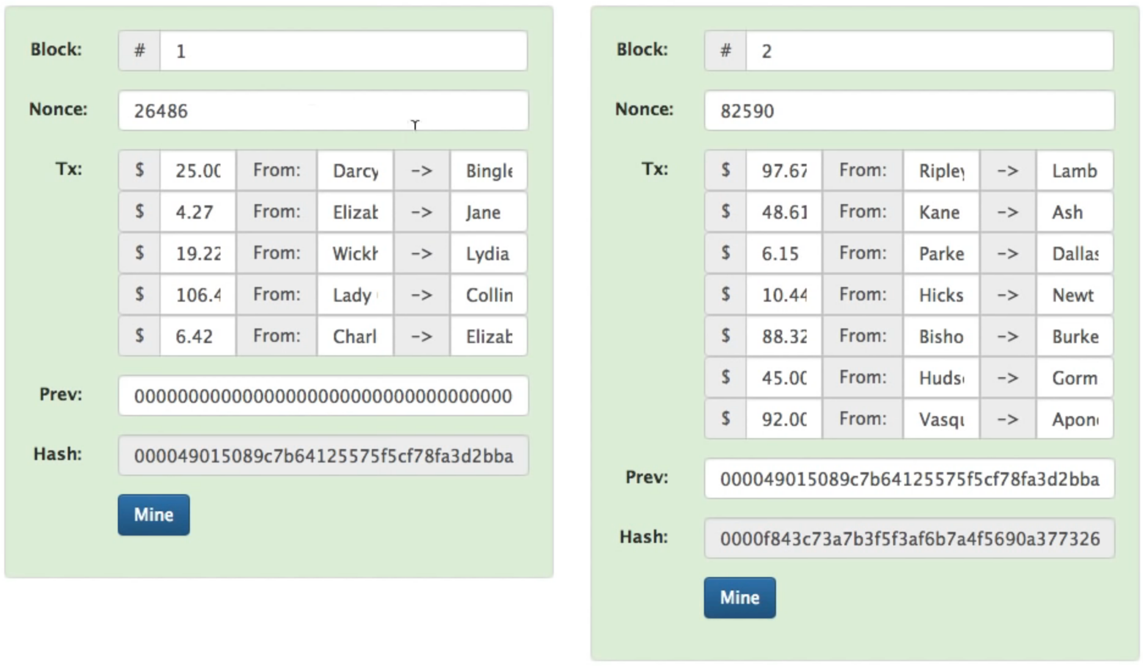

Slide 7
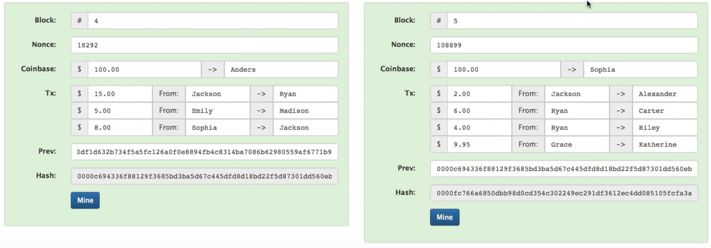

Slide 8
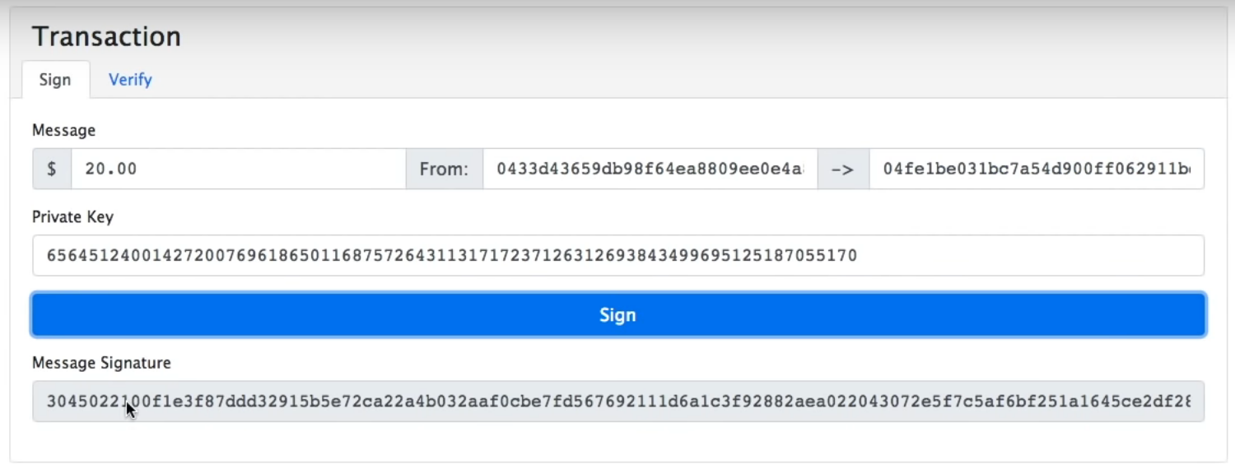


Slide 9
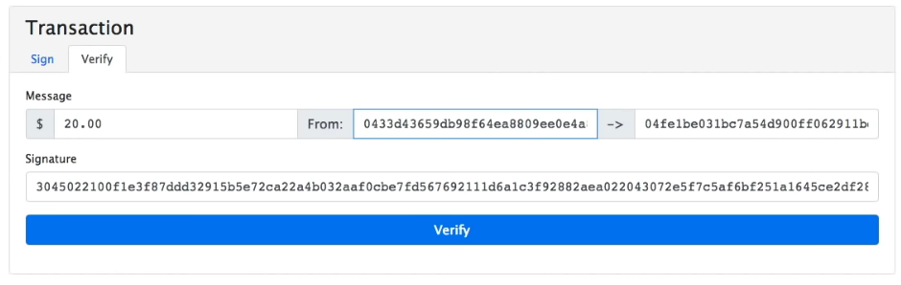


Slide 10
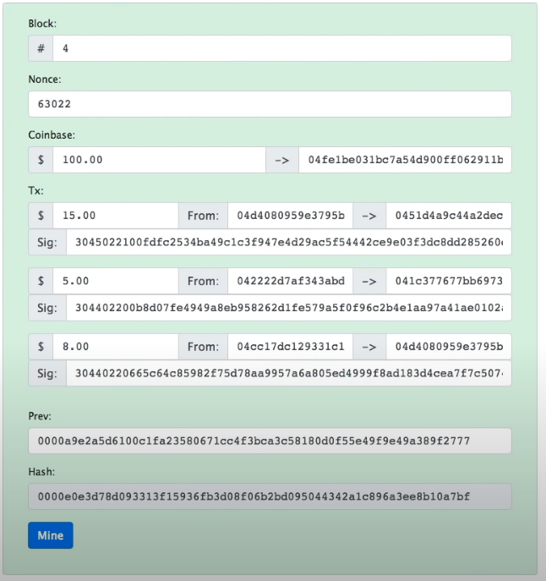

Slide 11
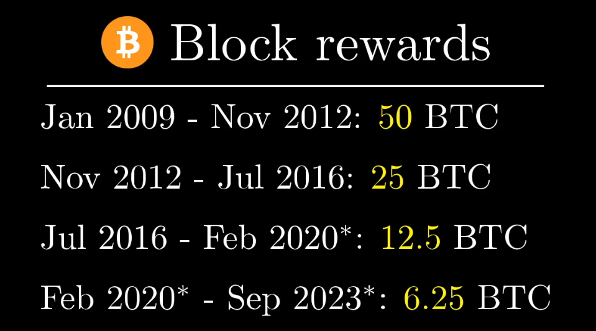
every 210,000 they cut in half the reward

Slide 12
Reason to mine
Limited to 2,400 transactions per block
VISA HAS AN Avg of 1,700/ second and a max of over 24,000/second
Tip the miner on transition

Slide 13
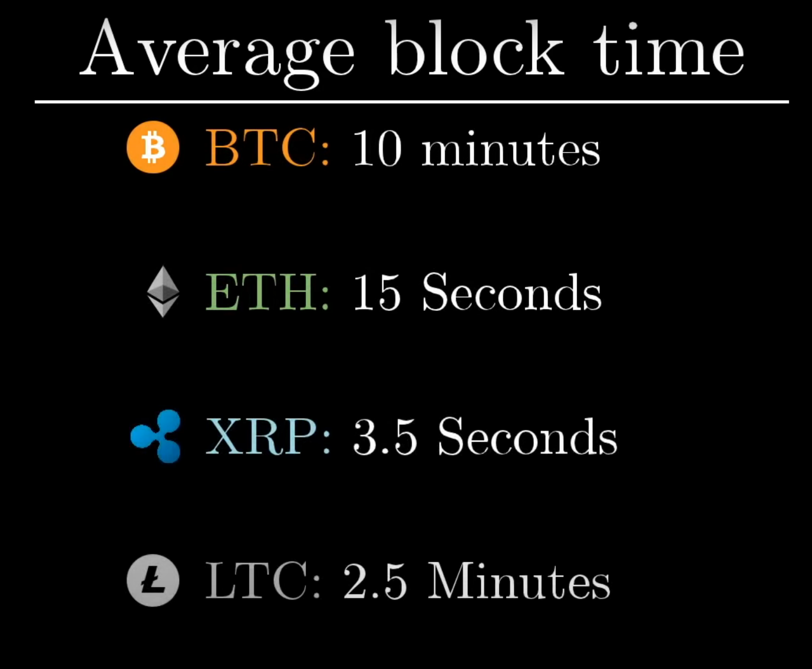
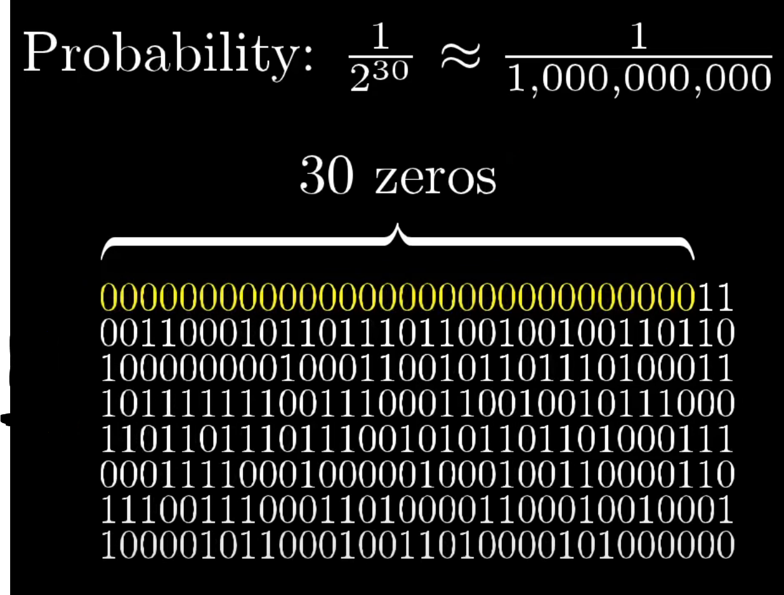
Proof of work

Slide 14
